Slide 1
GENE TARGET IDENTIFICATION FOR EPIGENETIC DISORDERS USING MICROARRAY DATA
Guide:
Dr. M. Viswajit
Assistant professor
Department of Biotechnology
Presented by:
N. Likhitha - 211FA14047
N. Likhitha Priya -211FA14050
M. Naga Anjana Gopinath -211FA14052

Slide 2






Objectives:
To identify and characterize the epigenetic modifications that are associated with epigenetic disorders, such as Rett syndrome.
The project might seek to identify specific Epigenetic markers or patterns that are associated with epigenetic disorders. These markers could serve as diagnostic tools or potential targets for drug development.
Simulations assess how a drug candidate interacts at a molecular level, aiding in predicting its efficacy and side effects prior to experimental validation.
Assess the clinical relevance of identified gene targets by correlating their expression levels with disease severity, progression, and treatment response in patient cohorts.
Explore the potential of identified gene targets as therapeutic targets for drug development, considering their biological functions and druggability.

Slide 3
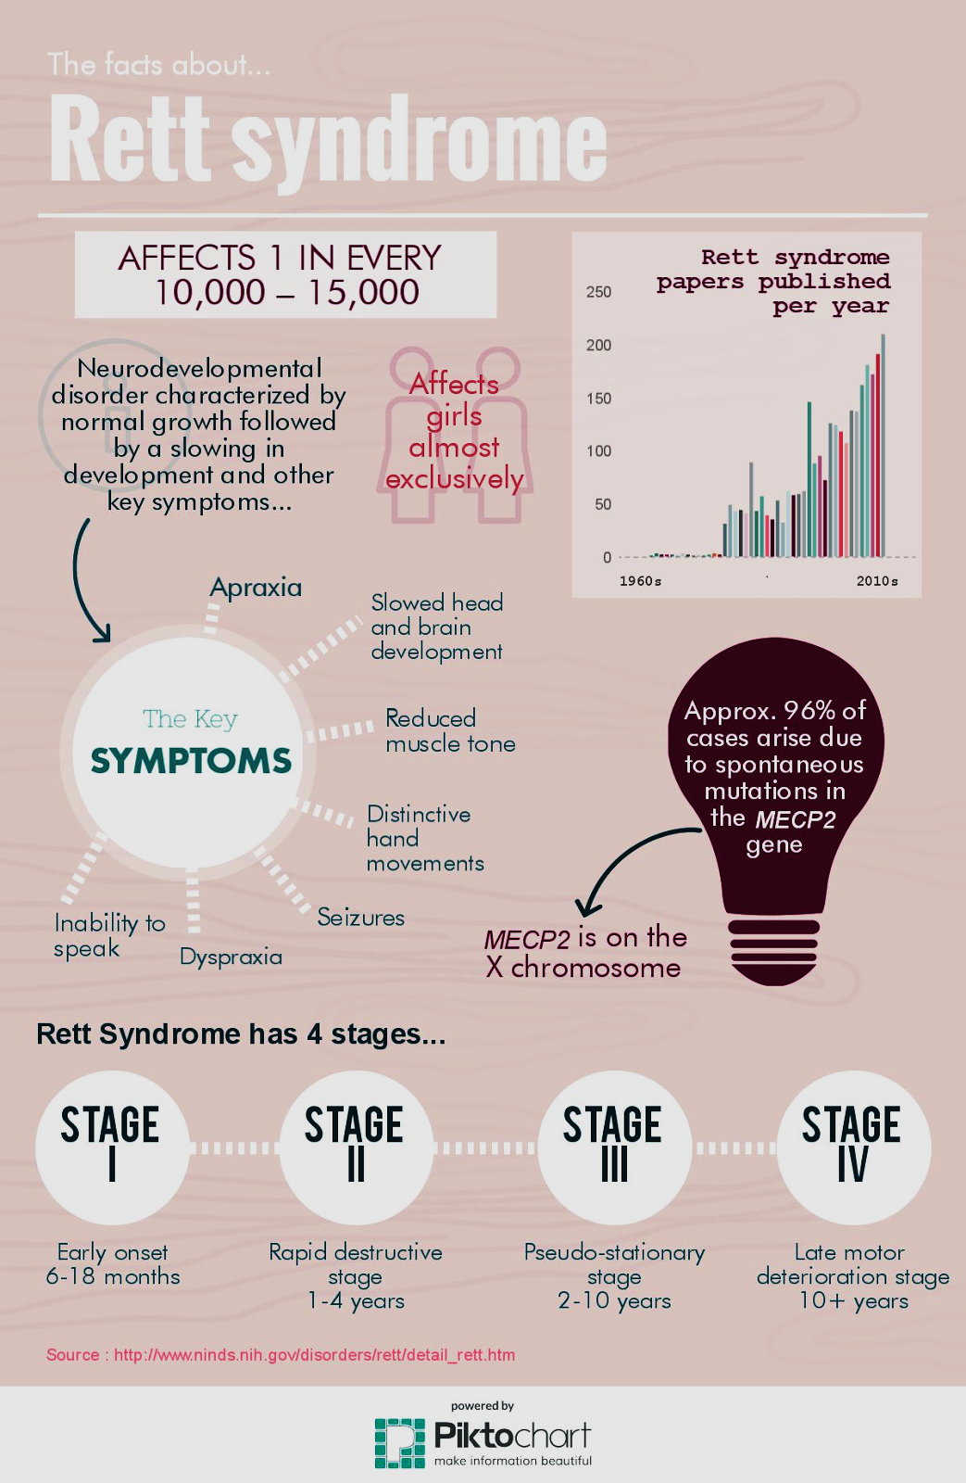
Facts About Rett syndrome:

Slide 4

Introduction
Rett syndrome is a rare neurodevelopmental disorder primarily affecting females, characterized by speech and motor function loss, seizures, and intellectual disability. Epigenetic dysregulation, particularly DNA methylation, plays a key role in its pathogenesis. Identifying gene targets is essential for developing targeted therapies. Microarray data analysis helps pinpoint dysregulated genes and pathways.
Computational techniques like homology modeling and docking studies aid in drug discovery by predicting protein interactions. Network analysis using tools like STRING and Cytoscape reveals biological pathways, guiding therapeutic interventions. QSAR analysis predicts drug activity and optimizes compounds. This study integrates these methods to identify gene targets and therapeutic candidates, aiming to accelerate treatment discovery for Rett syndrome.

Slide 5
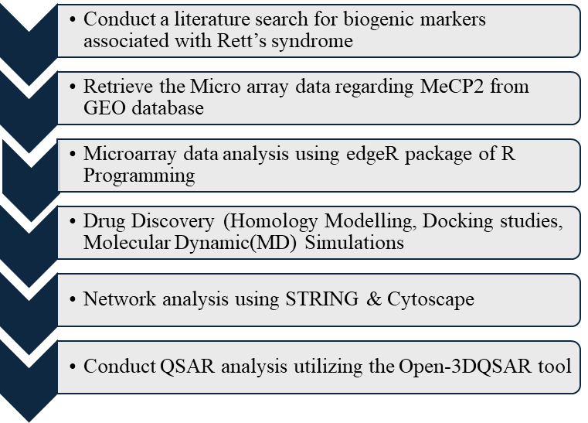
METHODOLOGY

Slide 6

Literature search:
Epigenetic disorders are diseases caused by changes in gene expression without alteration to the DNA sequence. They can be inherited or acquired.
When conducting a literature search for biogenic markers associated with Rett syndrome, it is observed that the MECp2 gene serves as a notable biomarker for this syndrome.
For performing microarray data analysis on Rett syndrome, we employed data retrieving from the Gene Expression Omnibus (GEO) database.
The information was retrieved from the dataset of accession number: GSE214548.

Slide 7
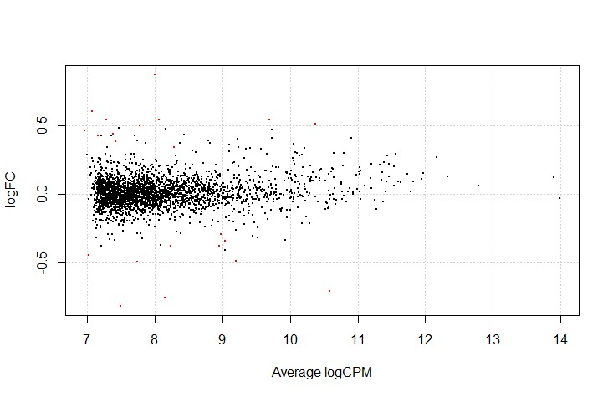
Micro Array Analysis using edgeR:
We Utilized the dataset GSE214548, encompassing nine distinct sets, including control, and rett syndrome datasets. And Cleaned the dataset, resulting in nine columns of data representing the three groups.
Grouped the cleaned datasets into three distinct groups, namely control, and rett syndrome to facilitate subsequent analysis.
Employed the edgeR package in R for MicroArray analysis. And Executed the analysis and generated CSV files containing logFC (log-fold change), logCPM (log counts per million), P values, and FDR values.
Applied filtering criteria on the CSV files, including a logFC Threshold of |2| and a significance threshold of less than 0.05 for probability values.
Through the filtering process, we identified a significant gene, CTCF, with the Ensemble ID ENSG00000102974.
Post edgeR analysis, generated a graphical representation to visualize the results, providing insights into differential gene expression patterns.

Slide 8

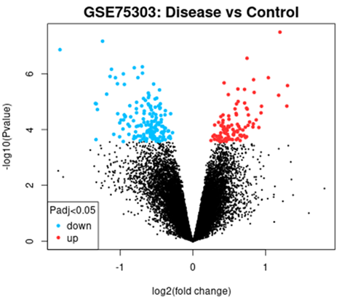
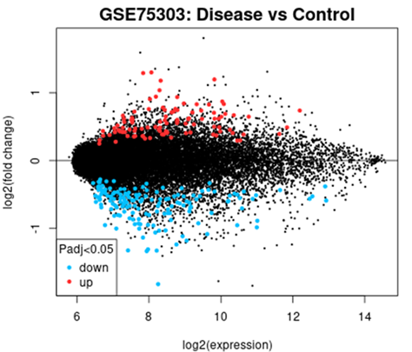
MICRO ARRAY DATA ANALYSIS FOR TRANSCRIPTOME DATA

Slide 9

Drug Designing
Homology Modelling
Docking Studies
Molecular Dynamics & Simulations

Slide 10
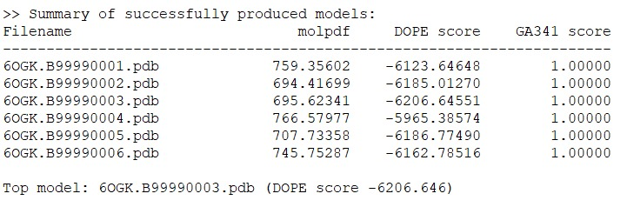
Homology Modelling:
Conducted a search for the CTCF protein in the Protein Data Bank (PDB) and identified a 3D structure with a high resolution (1.65 Angstrom), denoted by PDB ID 6OGK.
Noted a significant presence of missing residues in the 6OGK structure.
Addressed missing residues through homology modeling using Modeller, employing four templates with PDB IDs: 3C2I, 6YWW, 5BT2, and 6OGJ.
Following homology modeling, the third model was identified as the best model, characterized by a DOPE score of -6206.646.

Slide 11
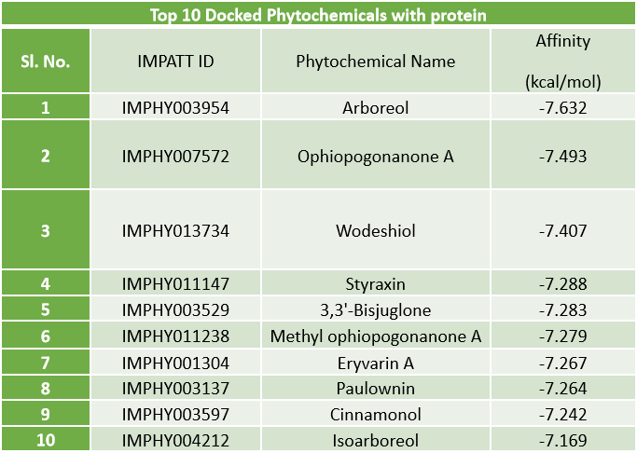
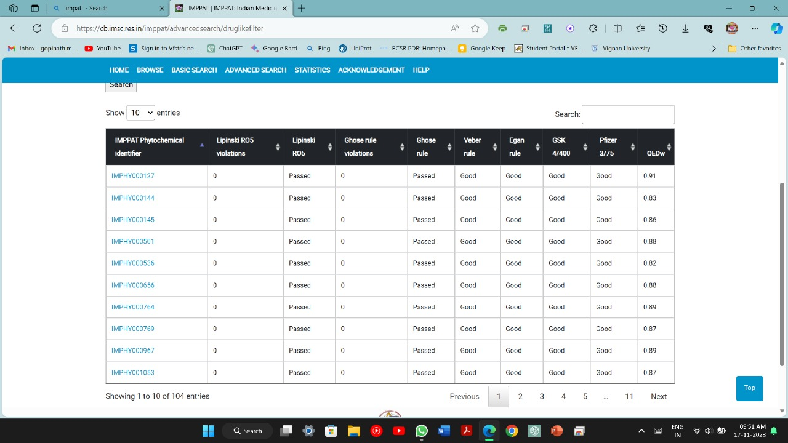
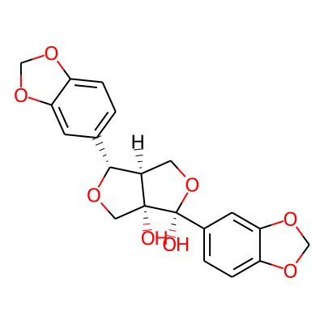
We retrieved a set of 100 phytochemicals from the IMPPAT database and evaluated their characteristics against established criteria including
Lipinski RO5 violation(zero), Ghose Rule violation(zero), GSK 4/400(good), Pfizer 3/75(good), Veber Rule(good), Egan rule(good), and QEDw (< 0.8).
Subsequently, protein-ligand docking was conducted using Autodock Vina for the 100 molecules, revealing that Arboreol, with an IMPPAT ID of IMPHY003954, demonstrated the most favorable affinity at -7.362 KCal/mol.
Docking
ARBOREOL

Slide 12
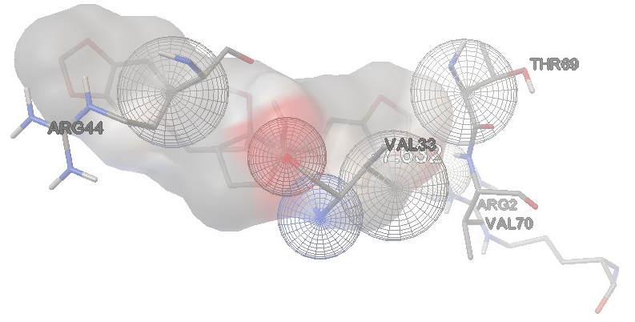
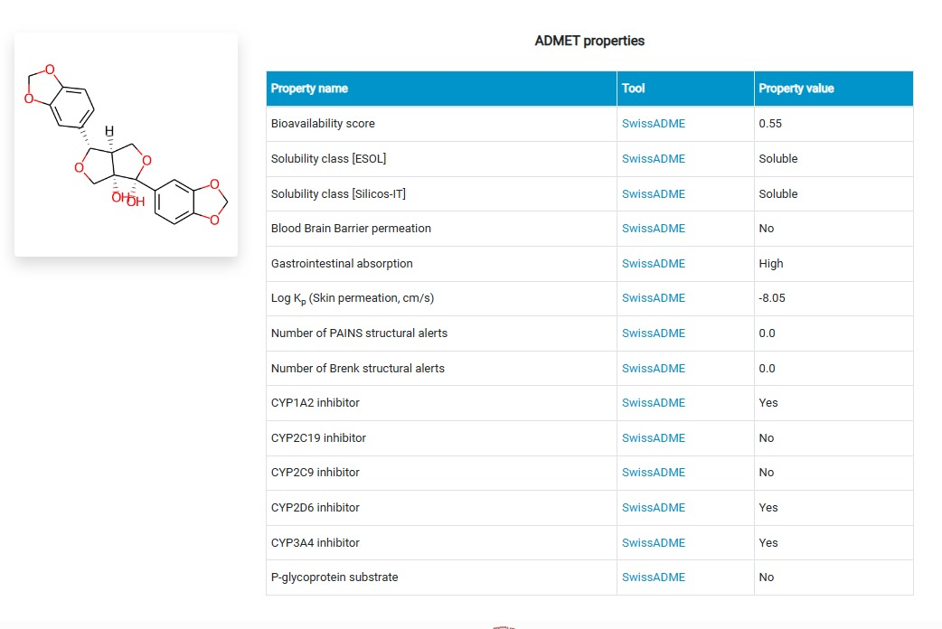
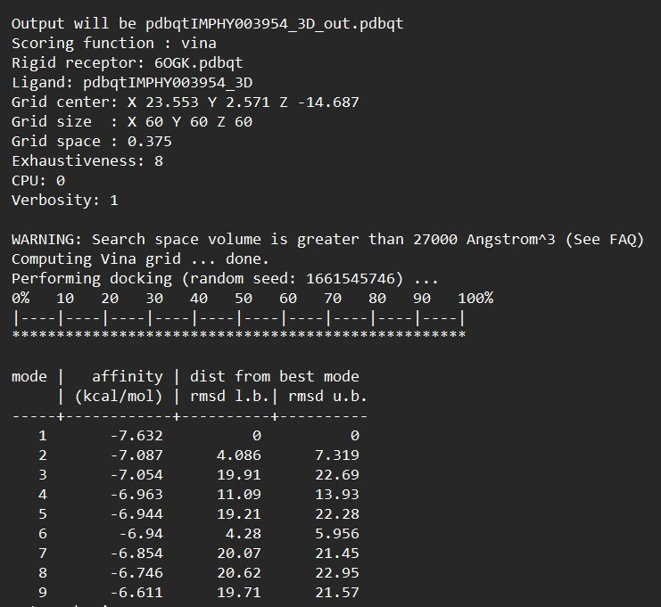
Docking Results
ADMET Properties of Arboreol

Slide 13

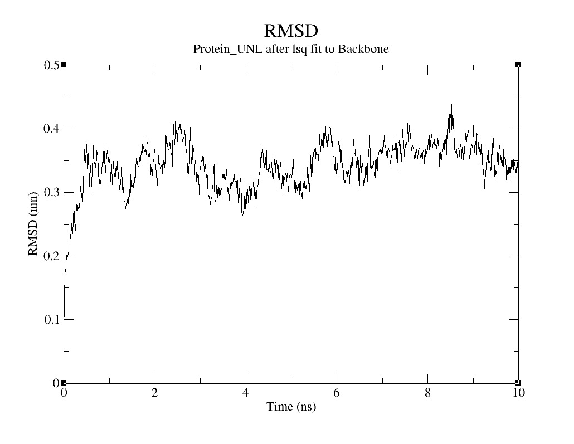

Molecular Dynamics and Simulations:
We Performed Simulations for docking analysis were conducted utilizing GROMACS, equilibrating the complex at a temperature of 300 Kelvin and a pressure of 1 Bar.
The obtained results include RMSD plots, hydrogen bonds, RMSF, Radius of Gyration and energy profiles for comprehensive analysis.

Slide 14
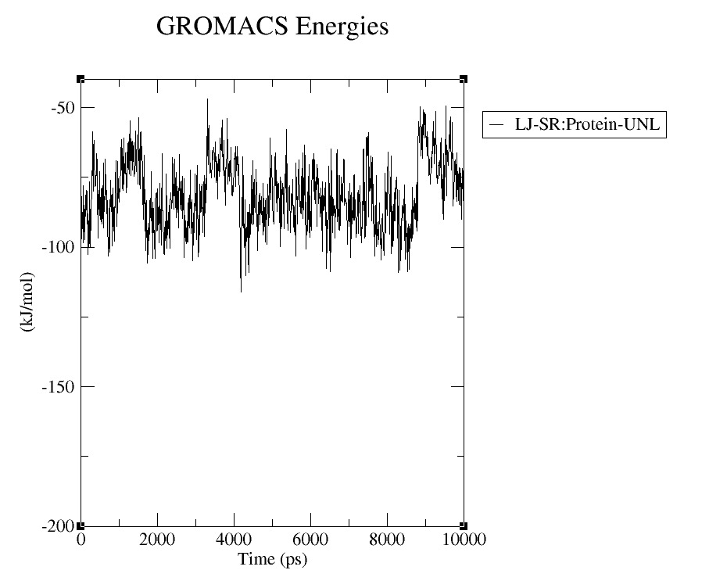
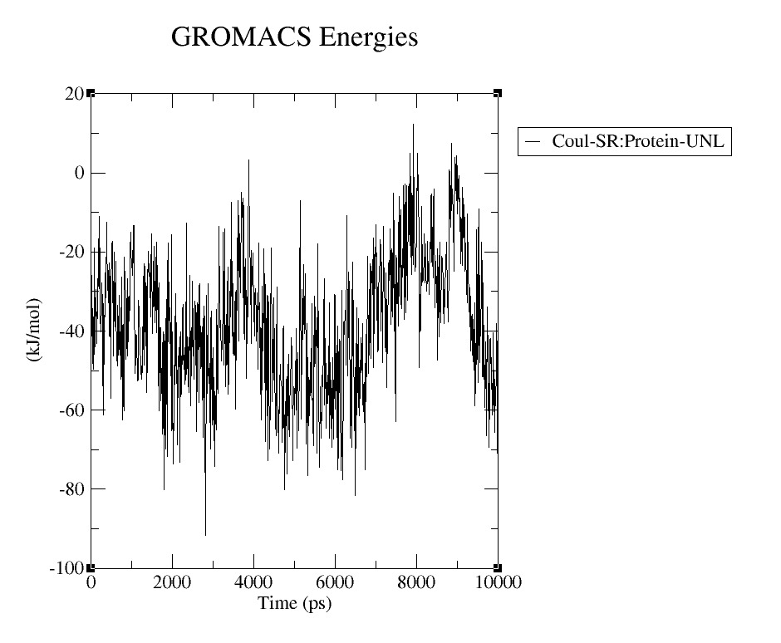
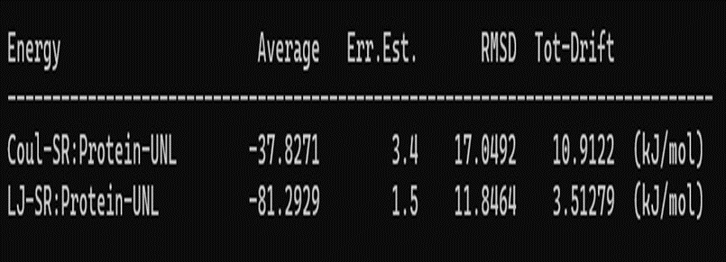
Interactions in Simulations

Slide 15
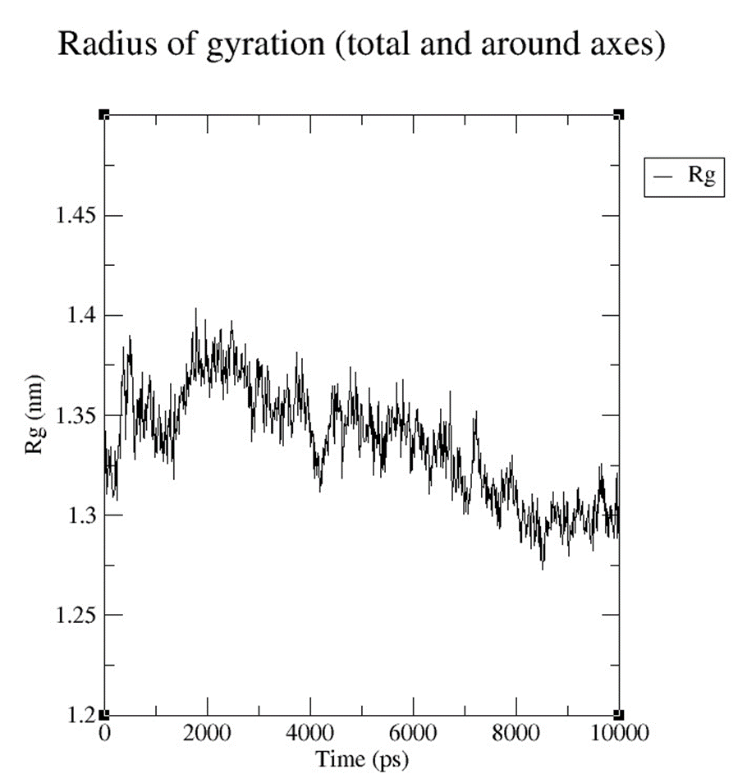
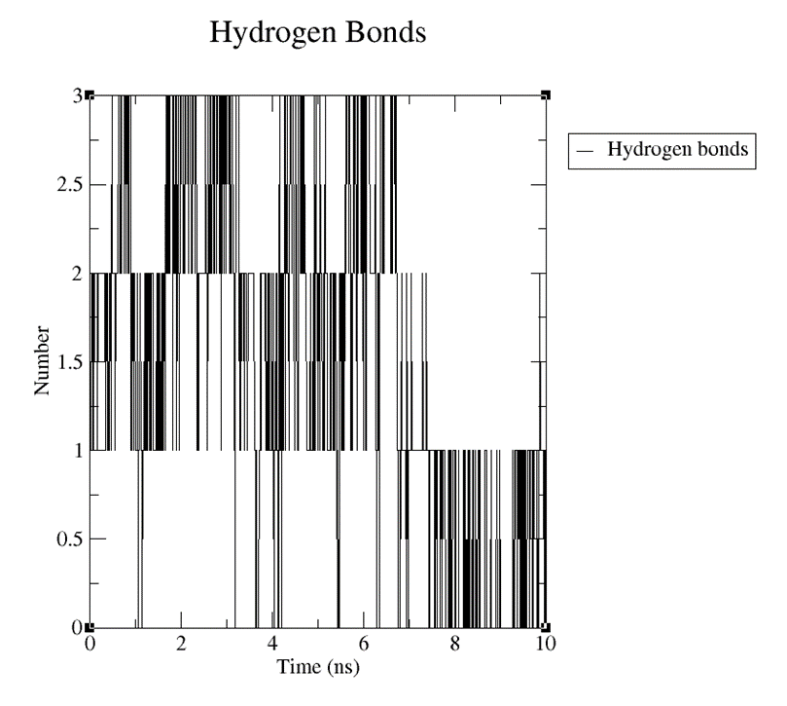
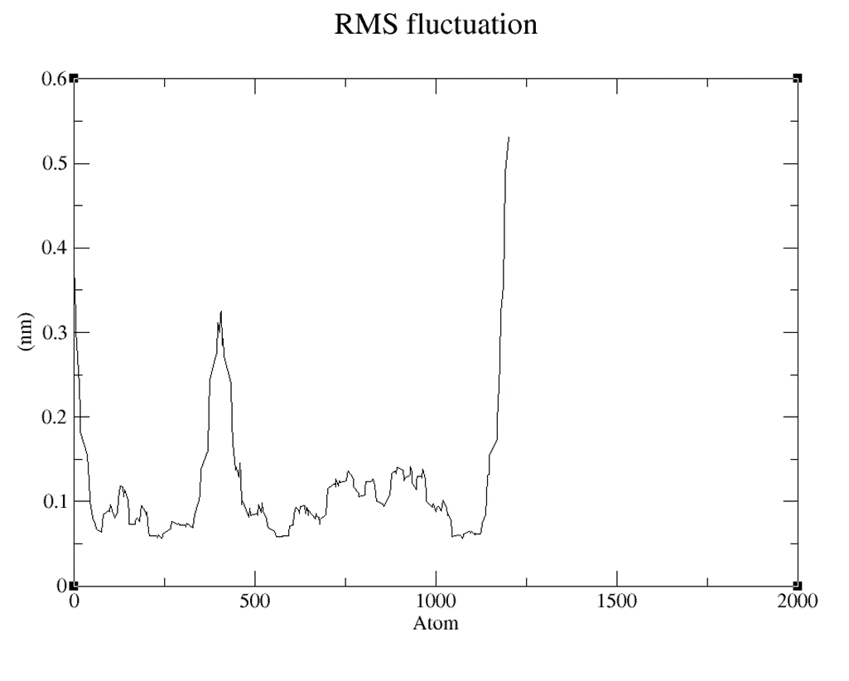
Molecular Dynamic Simulations results

Slide 16
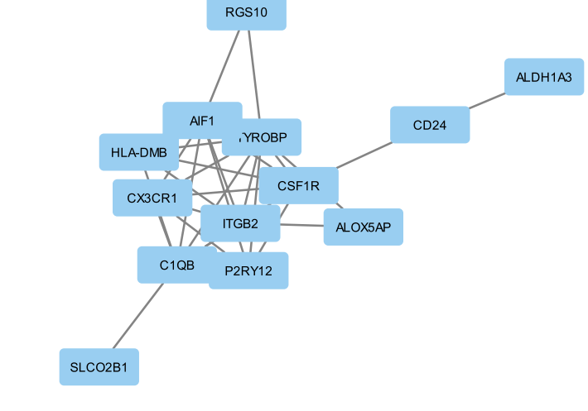
Network analysis for CTCF
Following Micro array analysis pinpointing genes implicated in Rett Syndrome, with a particular focus on MECP2, we conducted network analysis utilizing the STRING database.
Subsequently, the dataset retrieved from STRING was employed to visualize the molecular interactions and functional associations among the identified Rett Syndrome-associated genes using Cytoscape, a powerful visualization tool.
Through network analysis within Cytoscape , genes with the highest degree and stress were identified, shedding light on their pivotal roles within the Rett Syndrome-associated gene network.
Illustration of network from Cystoscape

Slide 17
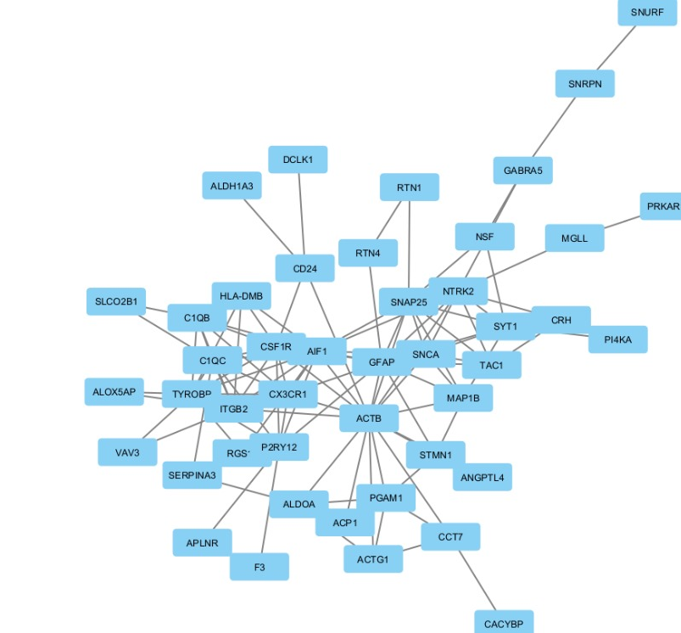
These high-degree and high-stress genes hold significant biological relevance, potentially serving as key regulators or effectors in Rett Syndrome pathology.
Detailed investigation into these genes provides valuable insights into the underlying molecular mechanisms of Rett Syndrome and unveils potential targets for therapeutic intervention, thus advancing our understanding and treatment strategies for this neurodevelopmental disorder.

Slide 18

Cont…
Gene Selection: Two genes, TYROBP and CSF1R, were chosen for analysis due to their relevance to Rett Syndrome based on their stress and degree values.
Database Search: A search was conducted on DGIdb website to identify molecules associated with TYROBP and CSF1R. Results showed 18 molecules for TYROBP and 50 molecules for CSF1R.
PubChem Analysis: Molecules associated with TYROBP and CSF1R were analyzed using PubChem database to assess their properties and activity.
Drug Bank Exploration: Molecules showing potential activity were further investigated using Drug Bank database to evaluate their protein binding properties and pharmacological activities.
Identification of Potential Drugs: Eight drug molecules were identified as having promising activity based on their properties and interactions.
3D QSAR Analysis: The identified drug molecules underwent 3D QSAR (Quantitative Structure-Activity Relationship) analysis to assess their potential efficacy in reducing Rett Syndrome symptoms.

Slide 19
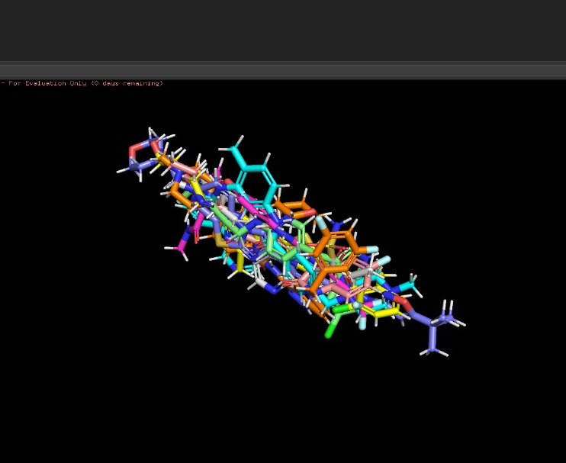
3D-QSAR
Building 3D-QSAR using Open3DAlign for initial alignment of a dataset, followed by Open3D-QSAR for quantitative structure-activity relationship (QSAR) analysis. In Open3DAlign, the dataset is imported, visualized, and optionally scrambled or realigned.
Alignment scores are computed to identify the best alignment, which is then visualized.
In Open3DQSAR, the aligned dataset is imported, activities are added, and molecules without activity data are removed. A grid box is set around the molecules, and Van der Waals and electrostatic Molecular Interaction Fields (MIFs) are computed. Sterically prohibited areas are excluded from electrostatic potential (ESP) calculations, and cutoffs are set.
The dataset is split into training and test sets, and variable identification and elimination are performed. Block Unscaled Weighting (BUW) is applied, followed by partial least squares (PLS) regression.
Calculated values are outputted in SDF format, and external validation is conducted. Variable grouping, selection, and model predictivity assessment are performed, with PLS coefficients exported as grid maps for visualization of isocontours in PyMOL.

Slide 20
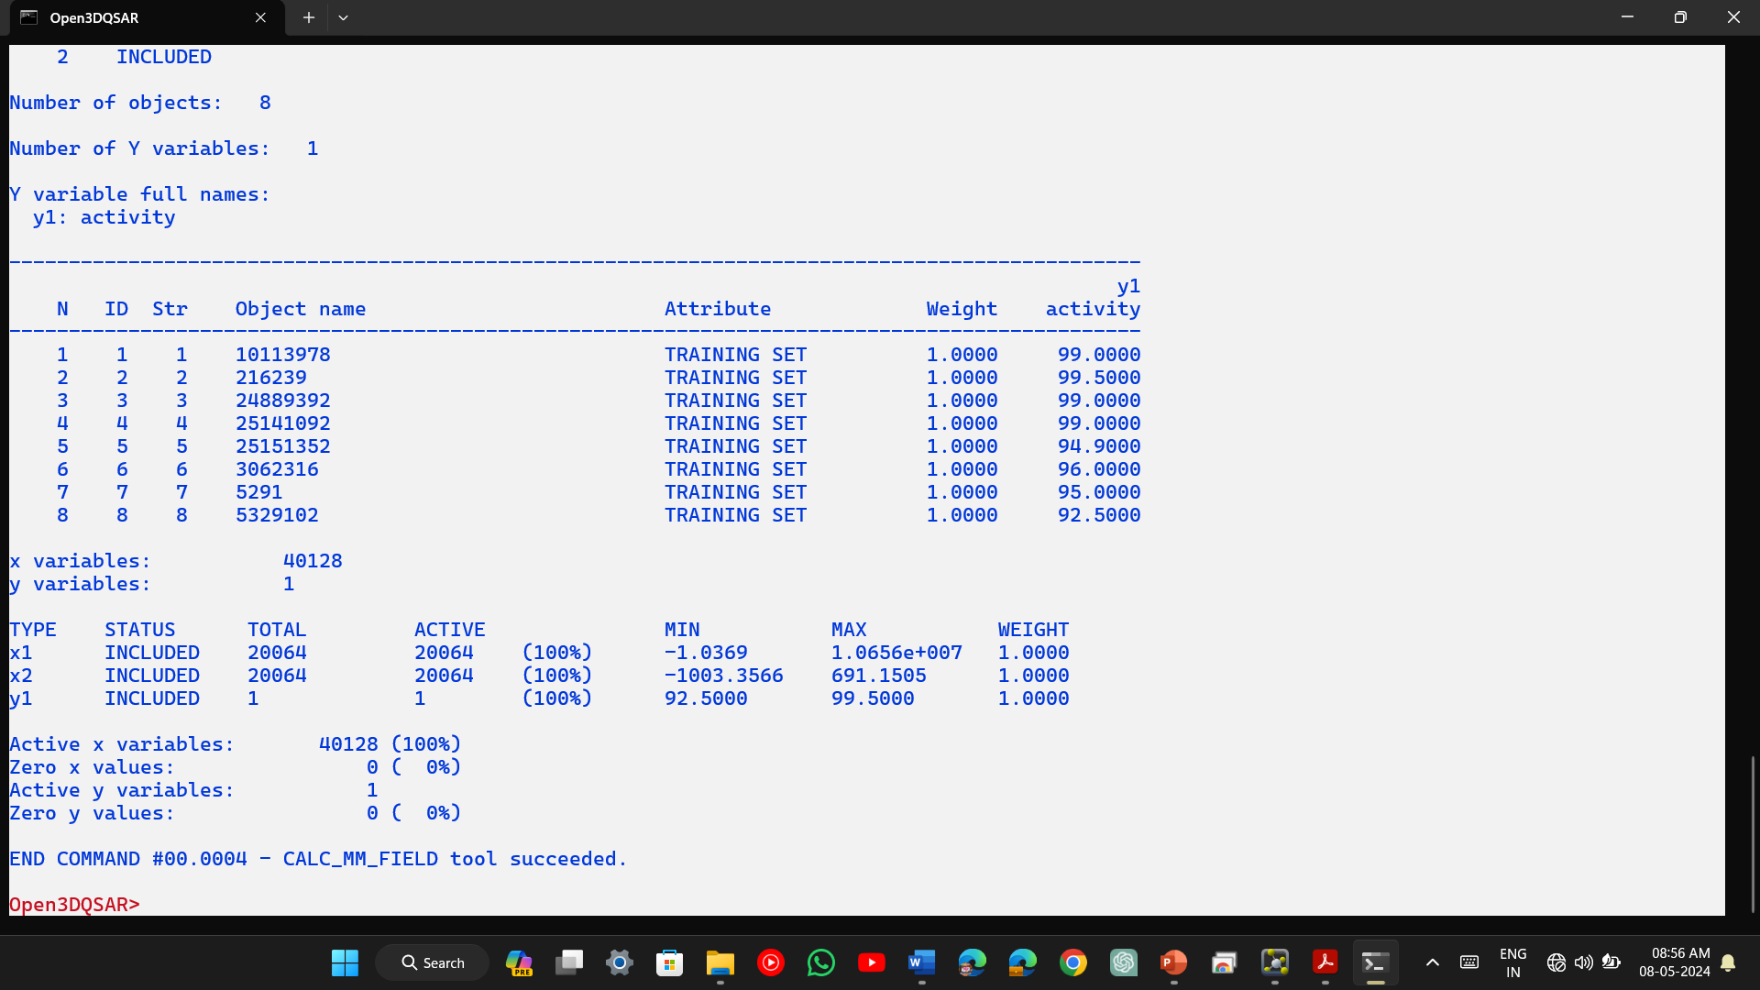
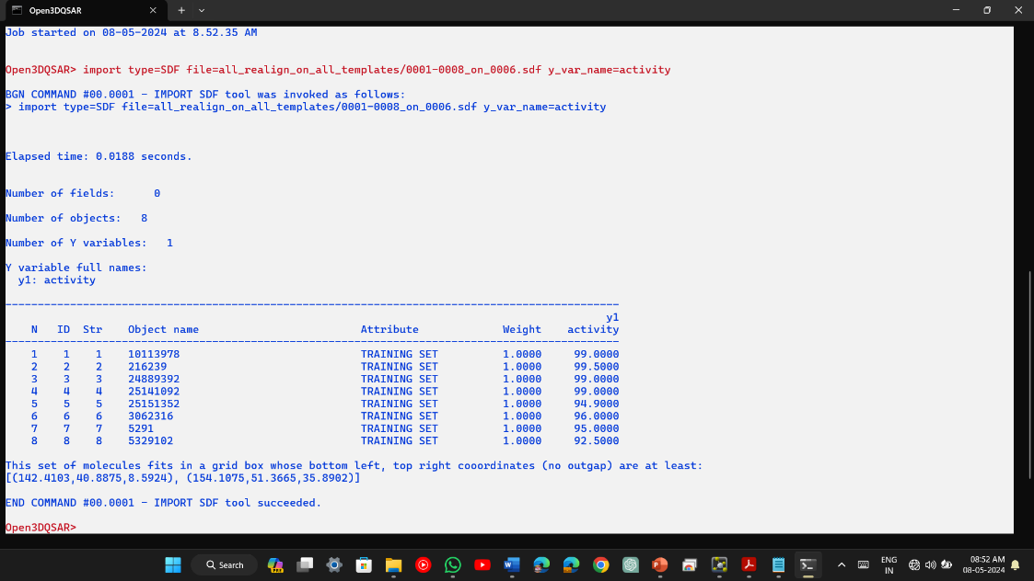
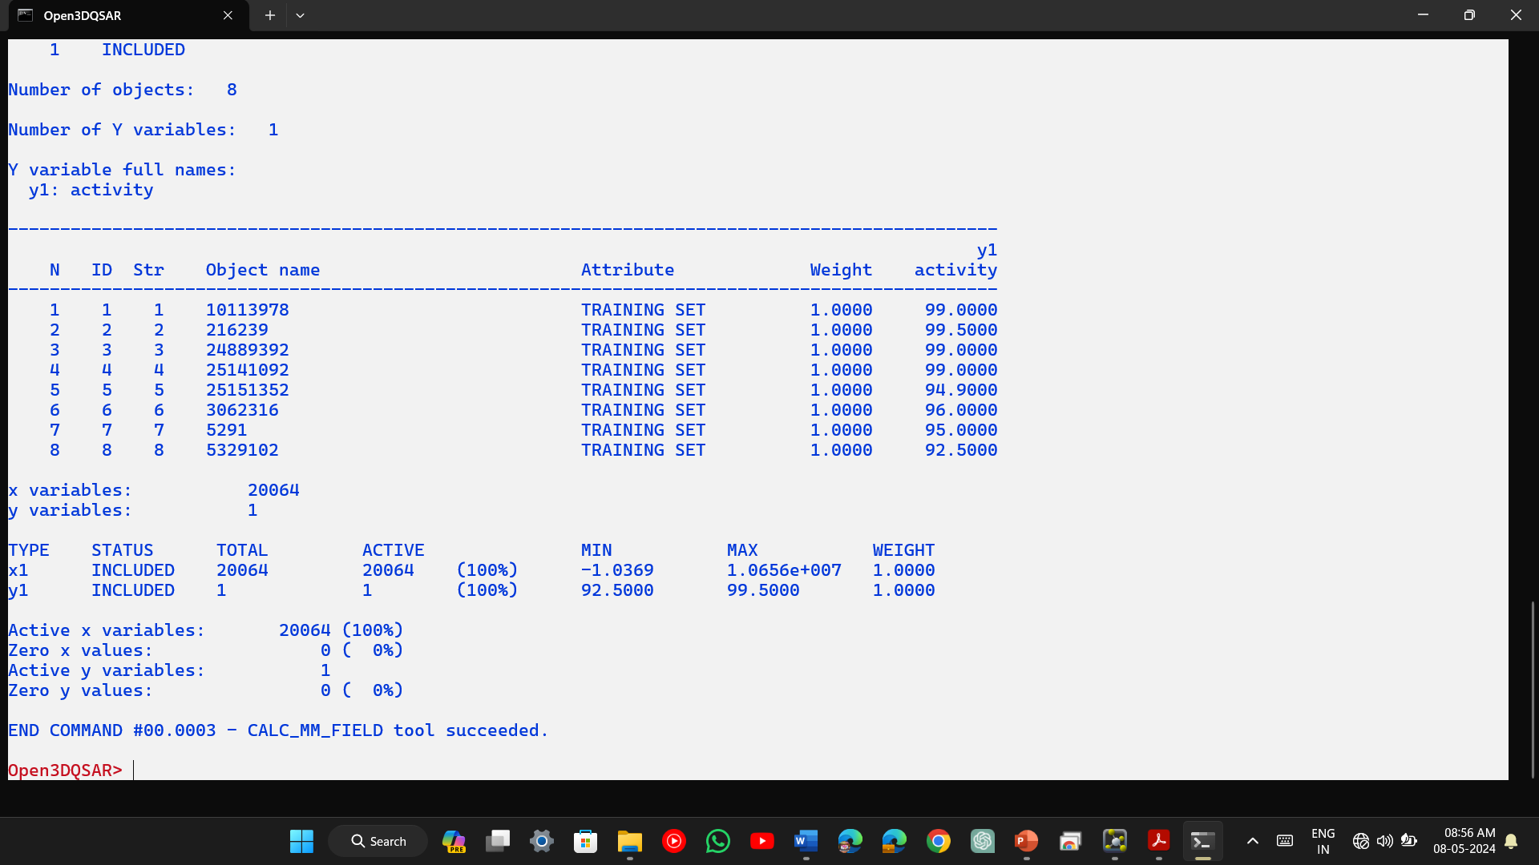
3D QSAR results

Slide 21
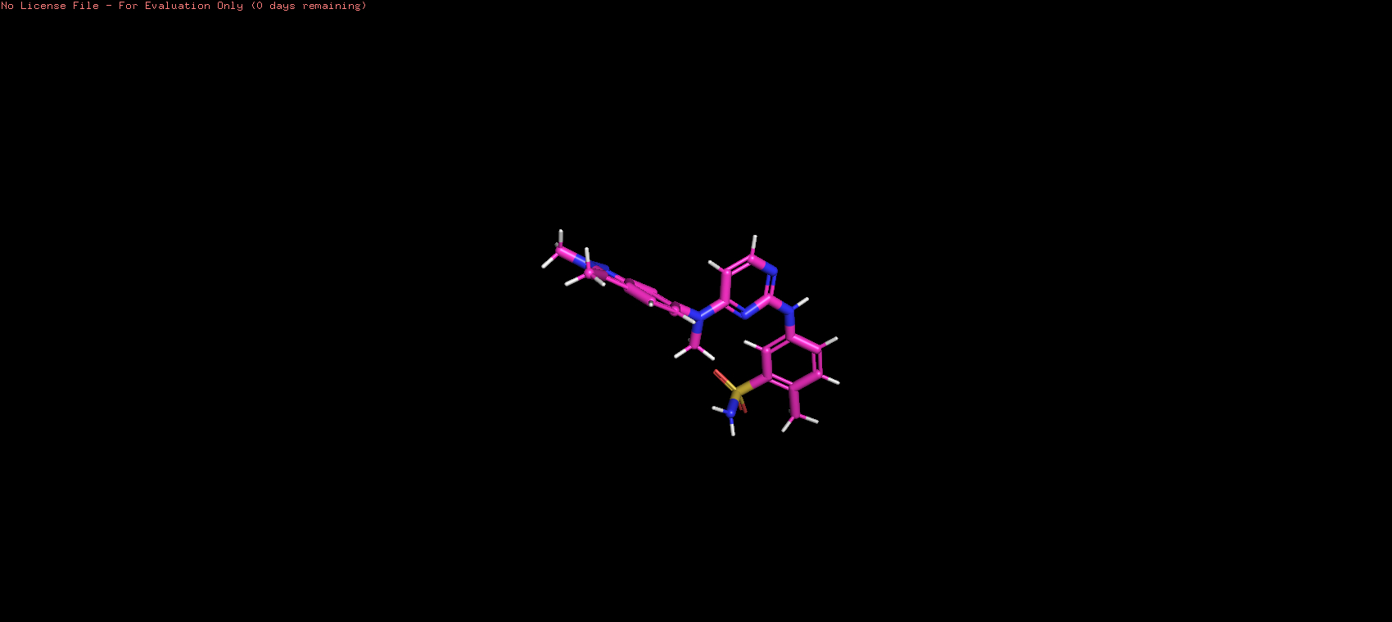
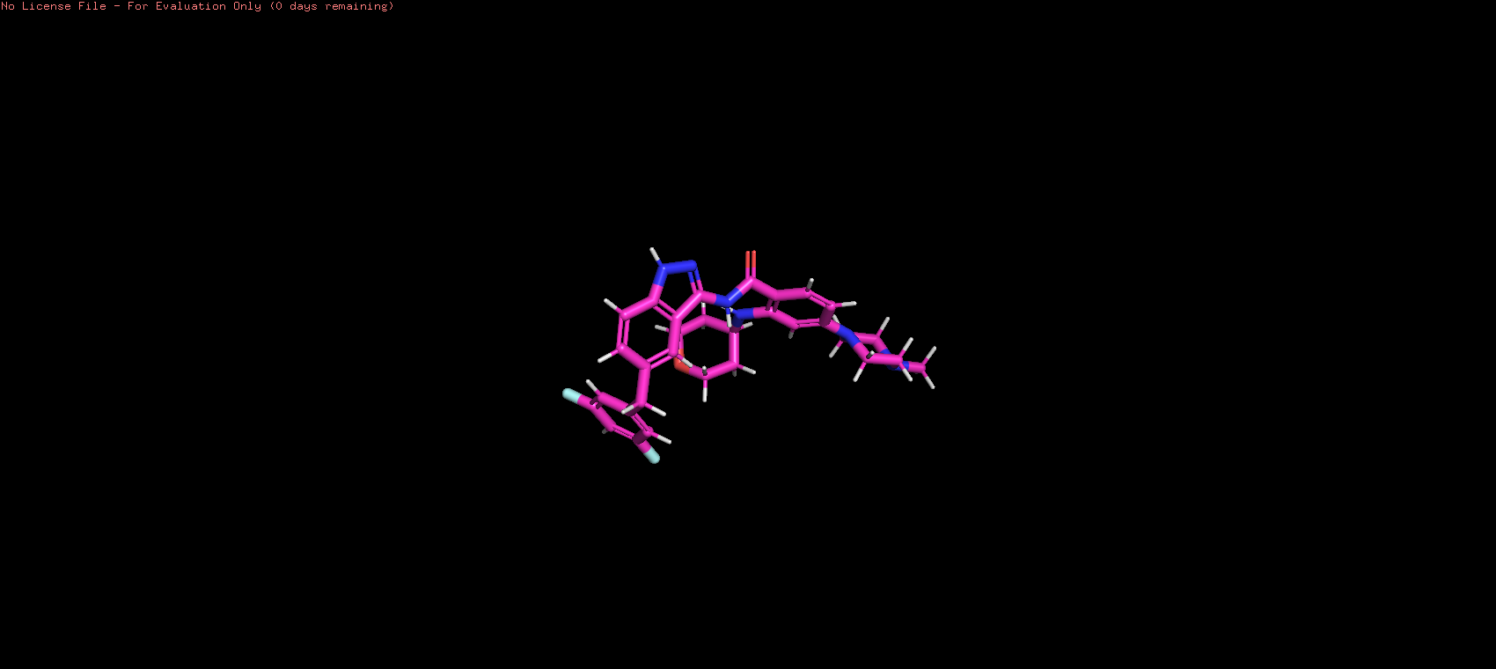

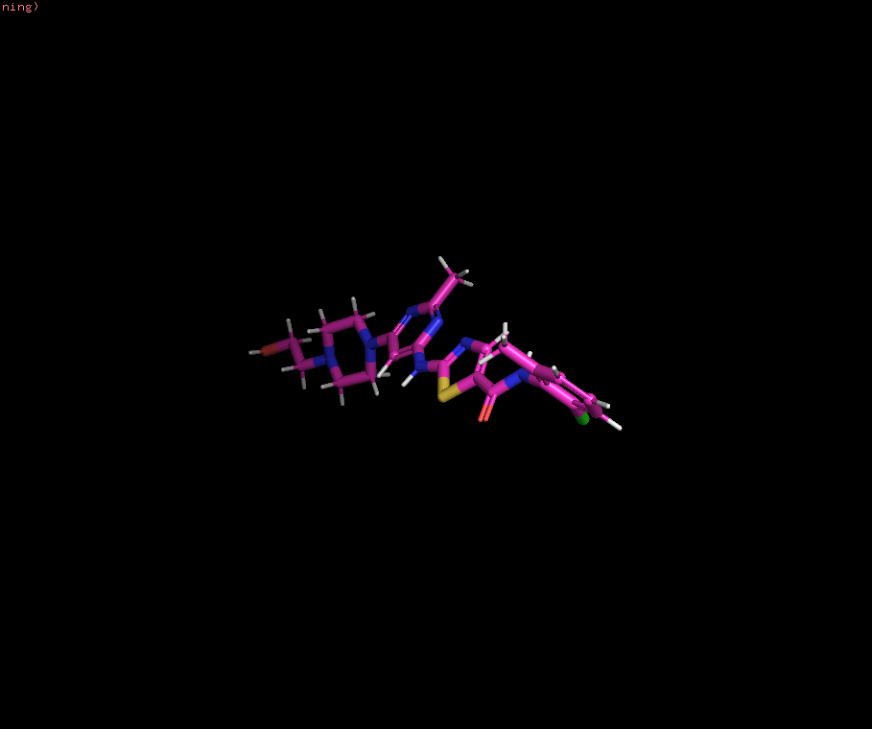
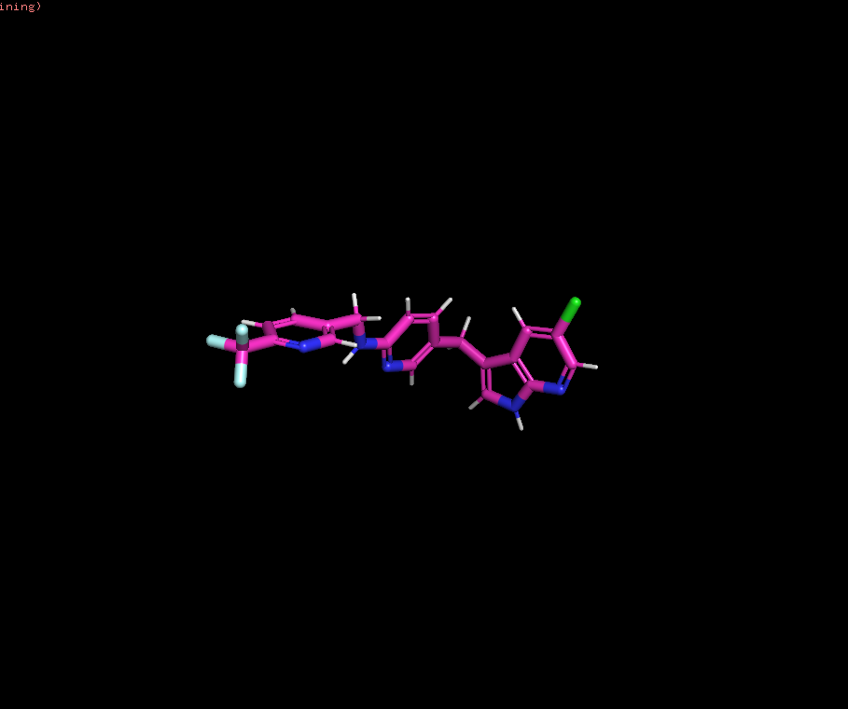
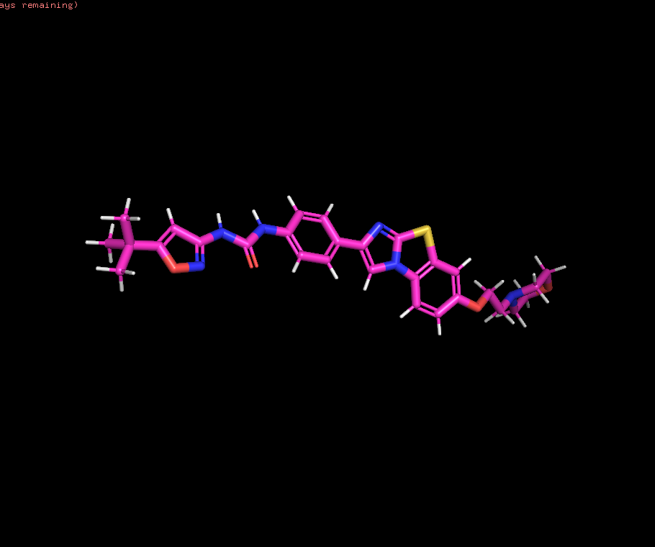
3D QSAR Models

Slide 22
Conclusion
The utilization of gene target identification through microarray data analysis has shown promise in advancing our understanding of epigenetic disorders like Rett syndrome. By identifying specific genes involved in the condition, we can potentially develop more targeted therapies and interventions to improve patient healthcare outcomes.
Additionally, this approach may also enhance drug efficiency by allowing for the development of personalized treatments tailored to individual genetic profiles. The integration of genomic data into healthcare practices holds significant potential for advancing the treatment and management of Rett syndrome and other similar disorders.

Slide 23

THANK YOU

